Slide 1

Kallam Haranadhareddy Institute of Technology (Autonomous) Chowdavaram , Guntur Dt. Amaravathi, Andhra Pradesh Affiliated to JNTUK, Approved by AICTE, New Delhi SMART WASTE MANAGEMENT SYSTEM Submitted by: 218x1a0434 - K. Vennela 218x1a0442 - K. Udaya Sri 218x1a0432 - K. Avinash 218x1a0422 - K. Murali Manohara Joshi Guided by: Dr. Ravikanth Sir
Batch No:7

Slide 2
CONTENTS
1.What is aws
2.Introduction of aws
3.Working of aws
4.Web services
5.Advantages & Disadvantages
6.Internet of Things (IOT)
7.Smart waste management system
8.Nodemcu esp8266
9. Ultrasonic sensor
10.MQ 135 sensor
11. Oled display
12.conclusion

Slide 3

WHAT IS AWS
AWS stands for Amazon Web Services, a cloud computing platform that offers a variety of services. It includes compute power, storage, databases, and machine learning services. AWS is available to individuals and businesses.
Features
Pay-as-you-go: AWS offers a pay-as-you-go pricing model.
Scalability: AWS scales to provide users with compute, storage, and throughput as needed.
Tools: AWS offers a variety of tools and services to improve management flexibility for IT resources.

Slide 4
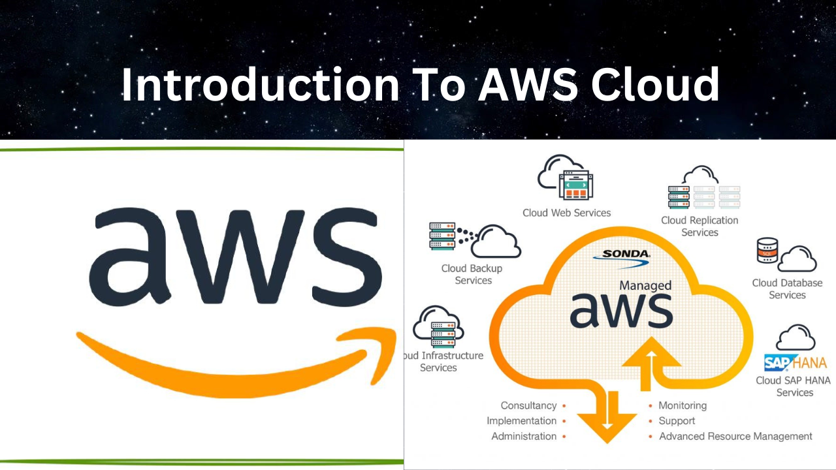
INTRODUCTION OF AWS
Amazon Web Services (AWS) is a leading top platform in providing the web services of various domains. AWS follows the trends of digital IT and comes up needy services with optimized performances covering a wide range of services from Compute to Storage. It covers a wider range of customers of different domains to expand their business operations. This Article covers the fundamentals of AWS and its scope of IT business.

Slide 5
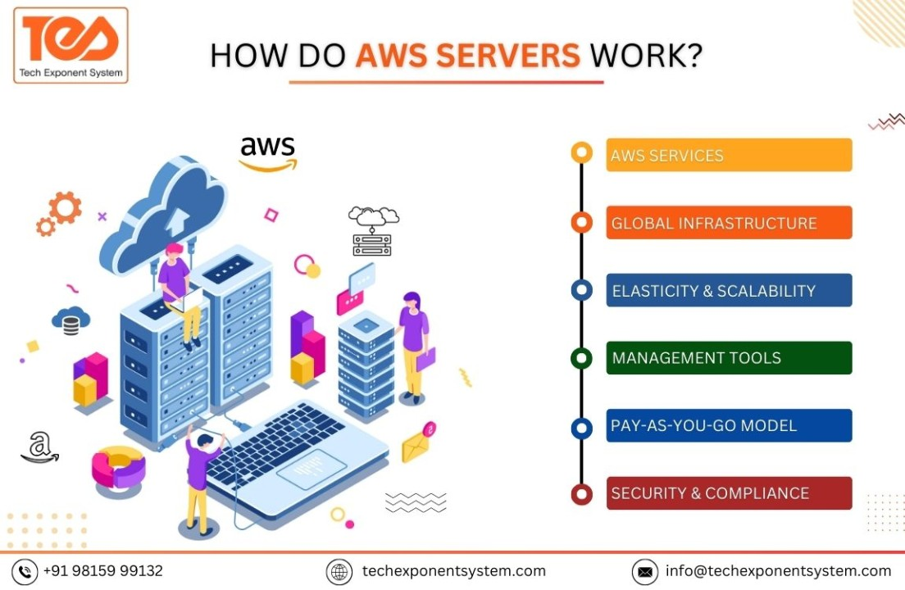
WORKING OF AWS
Infrastructure: AWS provides servers, storage, and other IT resources.
Security: AWS offers security tools, compliance, and governance services.
Scalability: AWS allows businesses to scale up or down quickly and easily.
Networking: AWS provides a private global network that connects regions and availability zones.
Services: AWS offers a variety of services, including databases, analytics, and machine learning.
OF

Slide 6



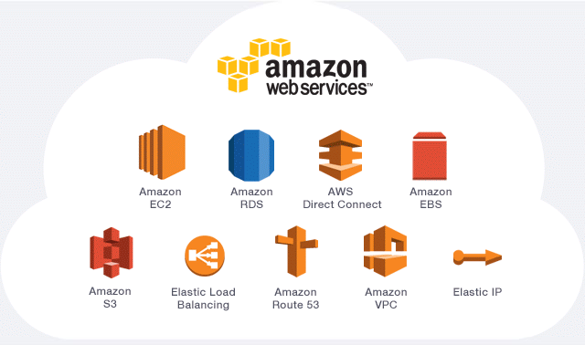
WEB SERVICES
Amazon Elastic Compute Cloud (EC2): Provides secure and scalable compute capability
Amazon Simple Storage Service (S3): Provides object storage through a web service interface
Amazon Elastic Block Store (EBS): Stores persistent data on AWS EBS servers
Amazon SageMaker: Provides the tools to build, train, and deploy machine learning
AWS Lambda: Runs code in response to events and automatically manages the underlying compute resources
Amazon RDS: Allows users to encrypt their databases
Amazon Simple Queue Service (SQS): A message queuing service for decoupling and scaling distributed components in applications

Slide 7
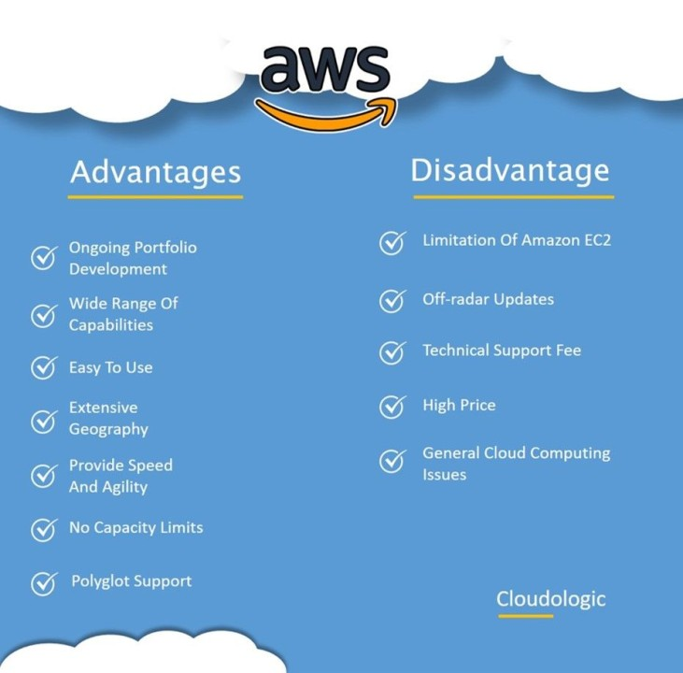
ADVANTAGES & DISADVANTAGES:
Walt Disney

Slide 8
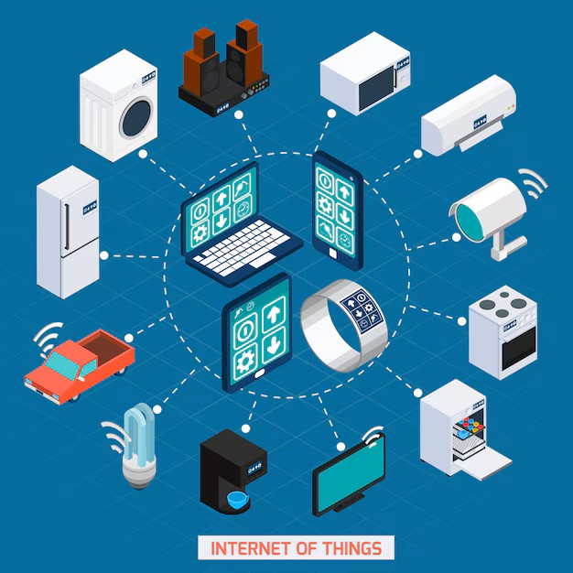
INTERNET OF THINGS (IOT)
The Internet of Things (IoT) refers to a network of physical devices, vehicles, appliances, and other physical objects that are embedded with sensors, software, and network connectivity, allowing them to collect and share data.
The term IoT, or Internet of Things, refers to the collective network of connected devices and the technology that facilitates communication between devices and the cloud, as well as between the devices themselves.

Slide 9
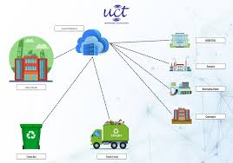
SMART WASTE MANAGEMENT SYSTEM
Smart waste management is about using technology and data to create a more efficient waste industry. Based on IoT (Internet of Things) technology, smart waste management aims to optimize resource allocation, reduce running costs, and increase the sustainability of waste services.

Slide 10
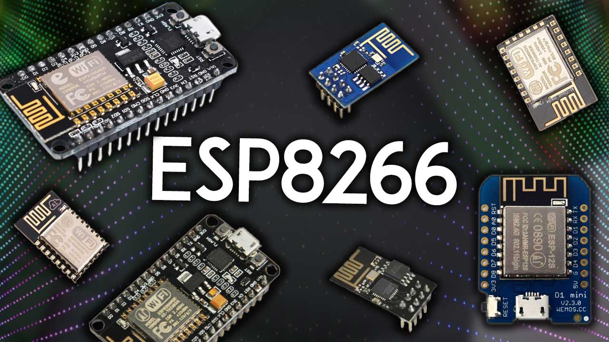
NODEMCU ESP8266
The ESP8266 is a low-cost Wi-Fi chip developed by Espressif Systems. It can be used as a standalone device, or as a UART to Wi-Fi adaptor to allow other microcontrollers to connect to a Wi-Fi network. For example, you can connect an ESP8266 to an Arduino to add Wi-Fi capabilities to your Arduino board
Node MCU is a development board and firmware based on the ESP8266 Wi-Fi chip, making it easy to prototype and build Internet of Things (IoT) products.

Slide 11
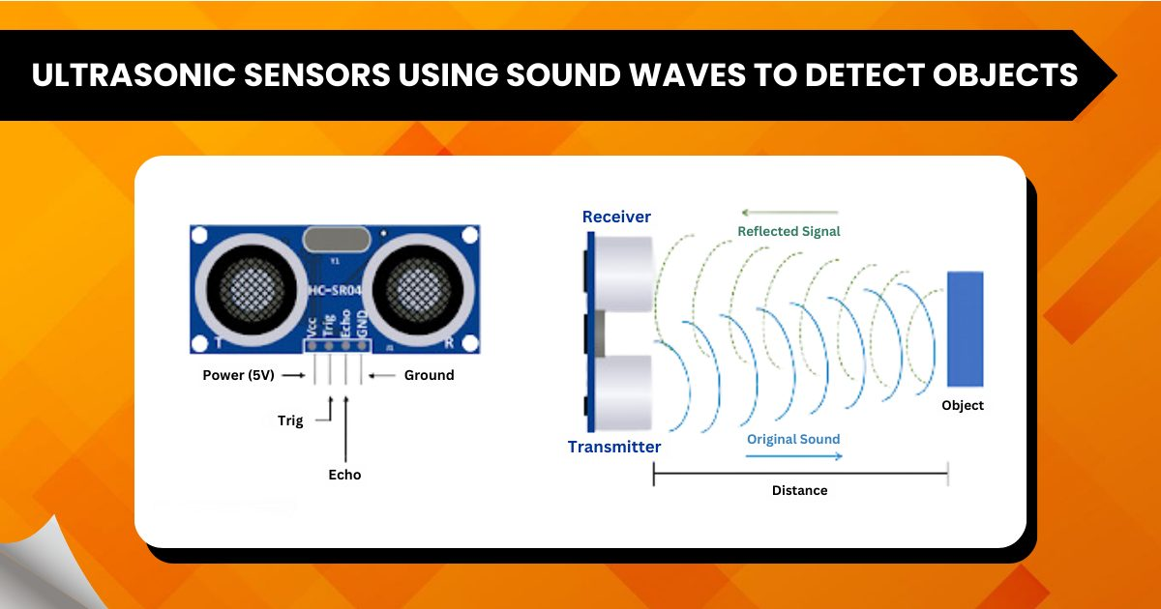
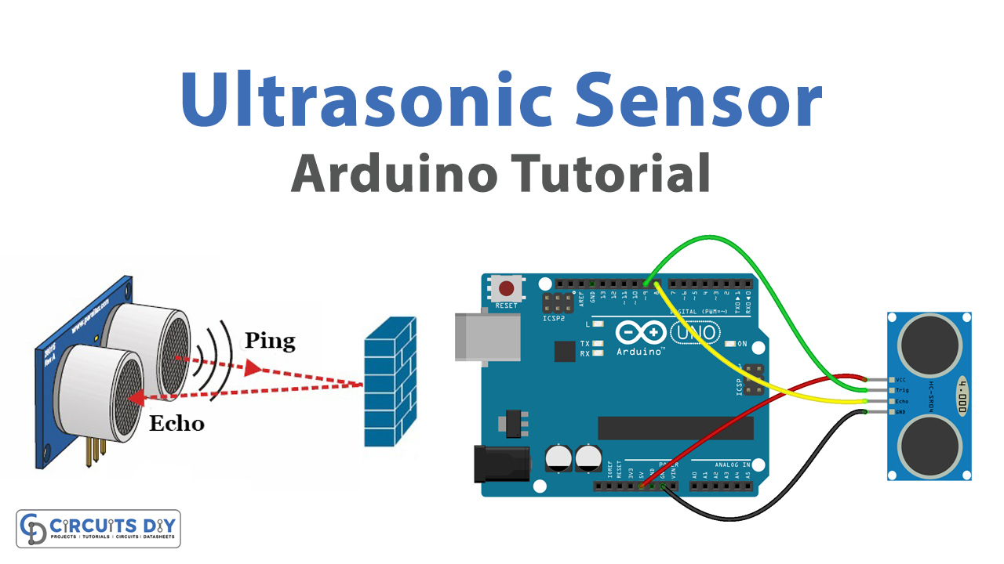
ULTRASONIC SENSOR
Ultrasonic transducers and ultrasonic sensors are devices that generate or sense ultrasound energy. They can be divided into three broad categories: transmitters, receivers and transceivers.
An ultrasonic distance sensor detects objects in a contactless manner and measures the distance between the sensor and the measured object. To do this, it cyclically emits a short, high-frequency sound wave at the sensor head. This travels through the air at the speed of sound.
Ultrasonic waves are sound waves with frequencies above the upper limit of a human's audible range (>20 kHz). "Sonic" means the audible range or sound humans can hear. In some definitions, it also refers to the speed of sound waves in air at 340 m/s.

Slide 12
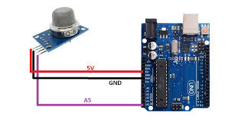
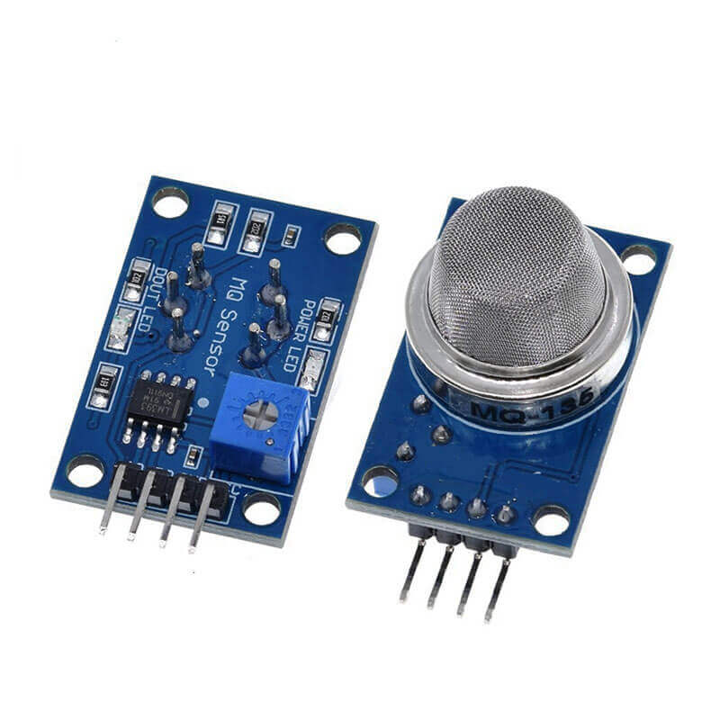
MQ135 SENSOR
MQ135 gas sensor has high sensitivity to ammonia gas, sulfide, benzene series steam, also can monitor smoke and other toxic gases well. It can detect kinds of toxic gases and is a kind of low-cost sensor for kinds of applications.
Gas Sensor(MQ2) module is useful for gas leakage detection (home and industry). It is suitable for detecting H2, LPG, CH4, CO, Alcohol, Smoke, or Propane. Due to its high sensitivity and fast response time, a measurement can be taken as soon as possible.
Message Queue, software-engineering component. IBM MQ, IBM computer software.

Slide 13
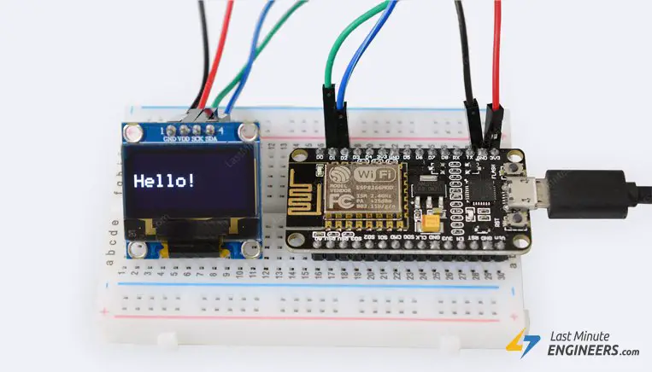
OLED DISPLAY
OLEDs are used to create digital displays in devices such as television screens, computer monitors, and portable systems such as smartphones and handheld game ...
The acronym 'OLED' stands for Organic Light-Emitting Diode, a technology that uses LEDs where the light is produced by organic molecules. These organic LEDs are considered to be among the best display panels available today.8 May 2024
OLED displays are generally better than LED displays for image quality, but LED displays are more affordable and durable.

Slide 14
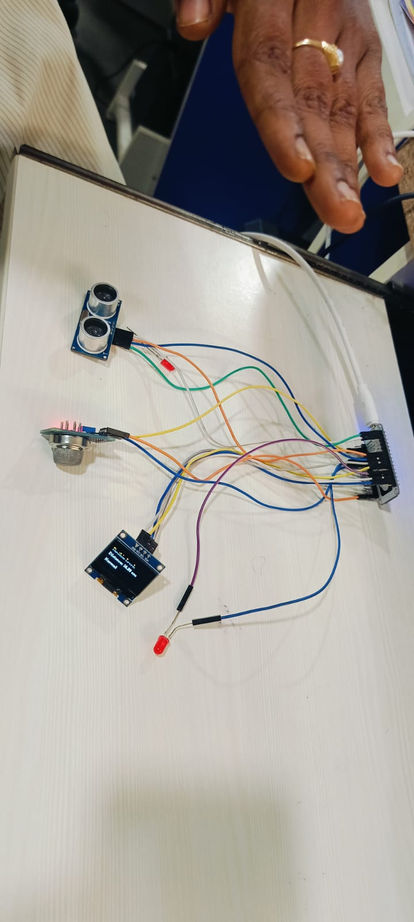
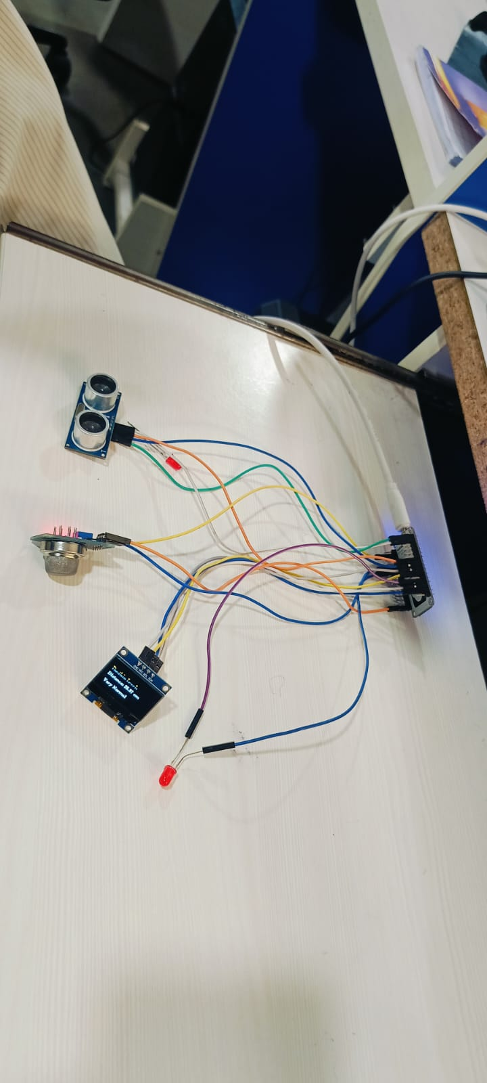
CONCLUSION
This smart waste management project demonstrates the potential of technology to revolutionize waste collection and management, offering a more efficient, sustainable, and environmentally friendly approach to urban waste handling

Slide 15
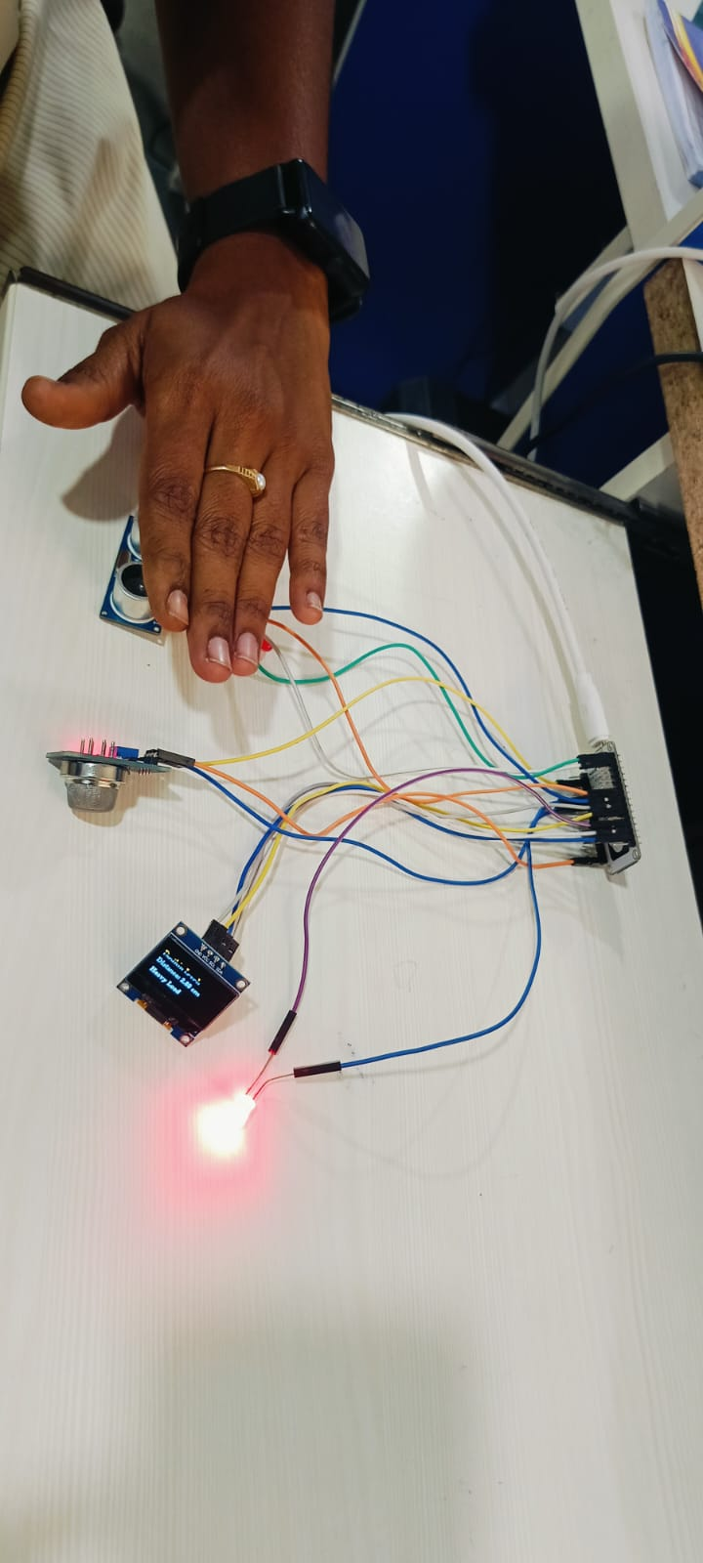
SWMS FINAL REVIEW :

Slide 16


